Slide 1
Constellations in the Sky

Slide 2
Constellation – one of the stellar patterns identified by name, usually of mythological gods, people, animals, or objects. Also includes the region of the sky containing that star pattern.
Most constellations do not look exactly like the creature for which they are named. You need to use a bit of imagination, just as the ancients did.

Slide 3
The constellations and names we use now in western culture originated in and have survived from the ancient civilizations in Mesopotamia, Babylon, Egypt, and Greece, from as early as 5000 years ago.
Of all the ancient constellations, about 48 are still in “use” and commonly named.

Slide 4
Since the roots of our western culture were generally in the northern hemisphere (northern latitudes), stars visible in only the southern hemisphere were not originally included in any constellations.
Some stars may have been included in more than one constellations, when constellations sometimes overlapped.

Slide 5
“Modern” astronomers have added 40 constellations as cultures have spread across the Earth, and separated overlapping constellations.
In 1928, the International Astronomical Union (IAU) officially established 88 constellations, each with its own stars and section of the sky (region of view).

Slide 6
In addition to the constellations, there are also asterisms, for example: the Big Dipper, which is part of the constellation Ursa Major.
Asterism – a named grouping of stars that is not one of the recognized constellations

Slide 7
Although constellations make a picture from our point of view, most of the stars that make up any single constellation, are not physically associated. Meaning they are generally not close to each other, even in the immense distances of space, and may be moving through space in different directions. They simply currently lie along a common direction when viewed from Earth.

Slide 8
Eight Important Constellations for our class to know and be able to locate.
1. Ursa Major 5. Scorpius
2. Ursa Minor 6. Leo the Lion
3. Orion 7. Draco the Dragon
4. Gemini 8. Pegasus
A guide to the 88 constellations

Slide 9
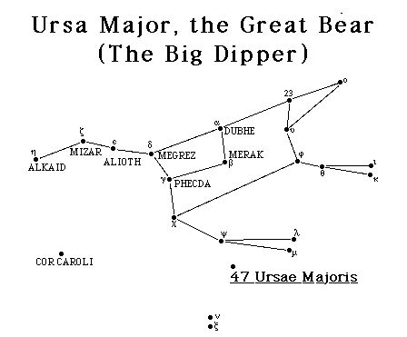
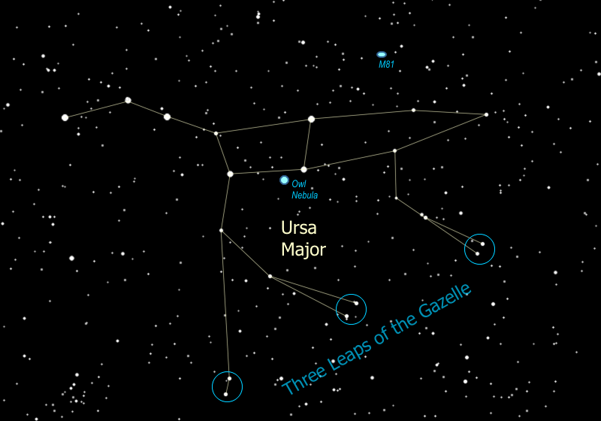
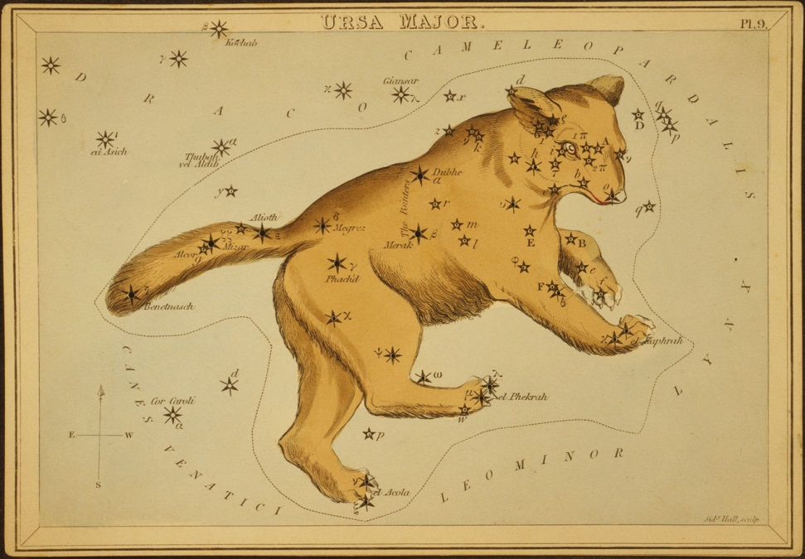
1. Ursa Major

Slide 10
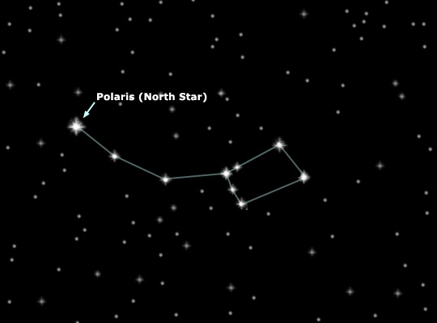
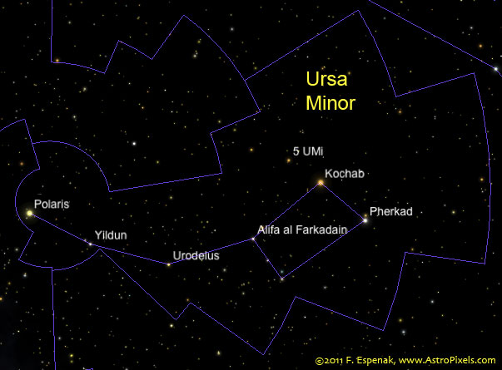
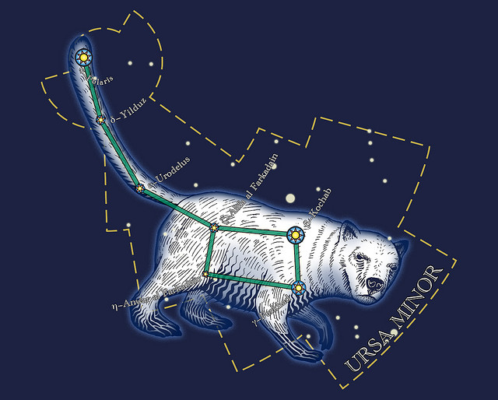
2. Ursa Minor

Slide 11
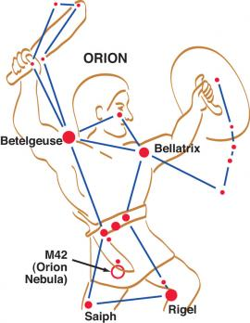
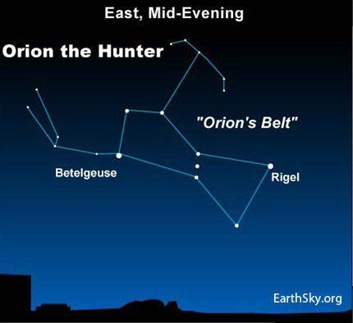
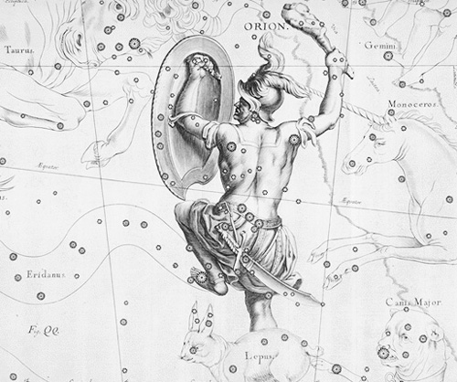
3. Orion

Slide 12
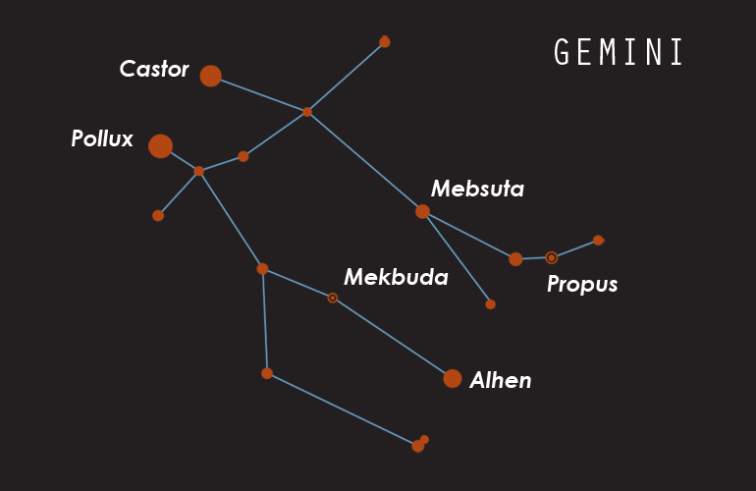
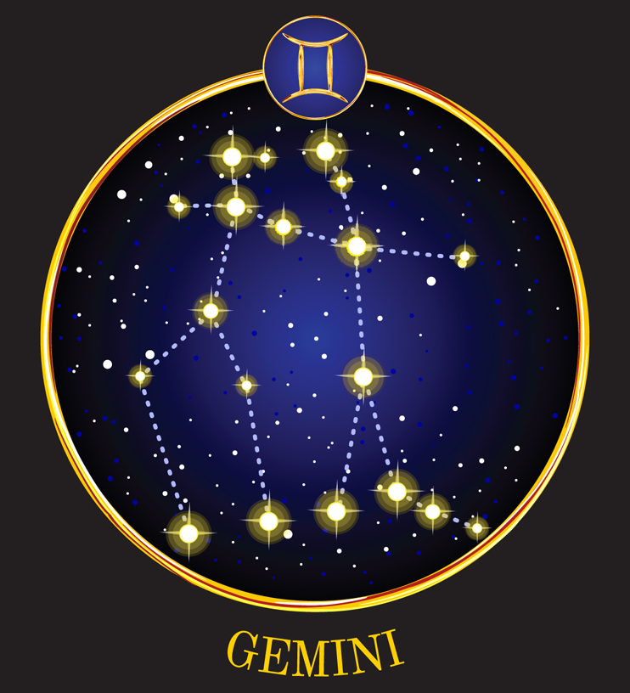
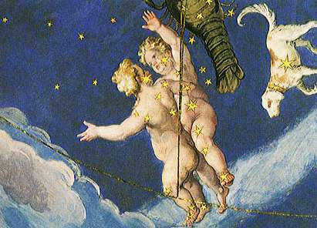
4. Gemini

Slide 13
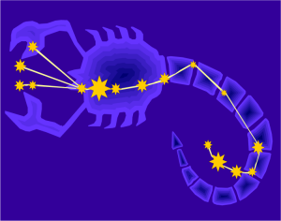
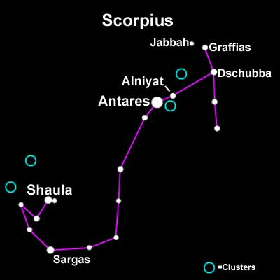
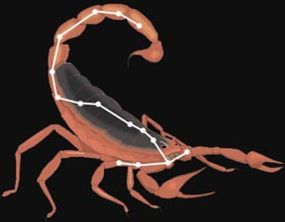
5. Scorpius

Slide 14
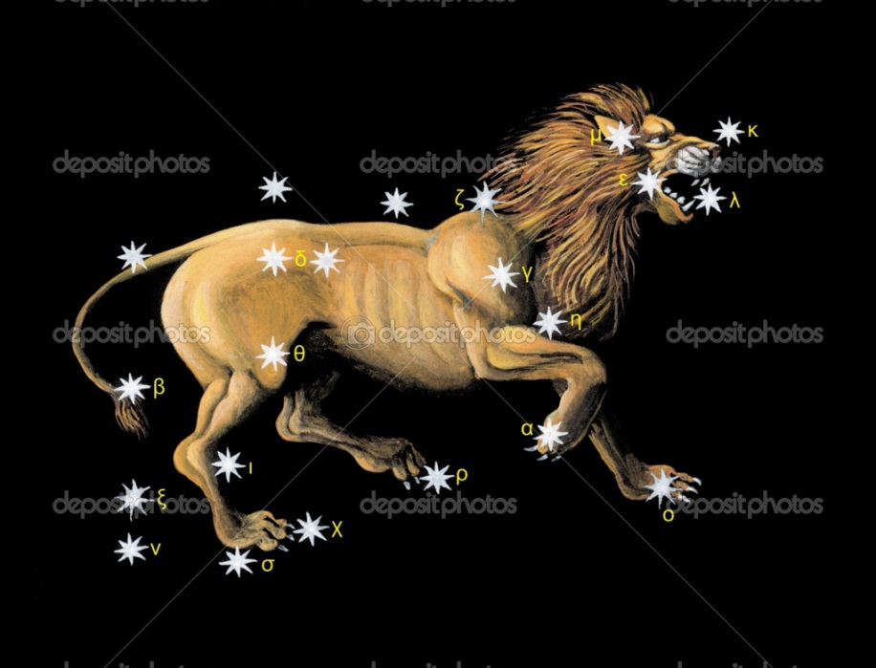
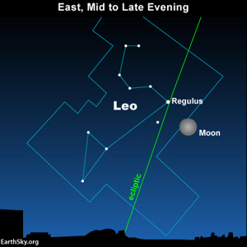
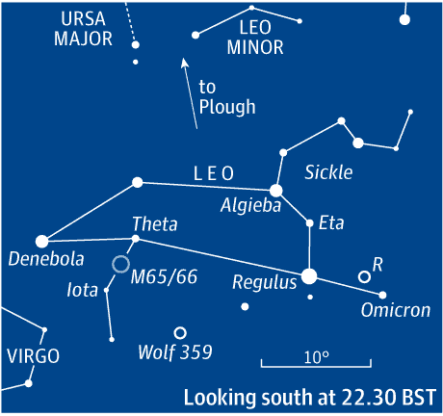
6. Leo the Lion

Slide 15
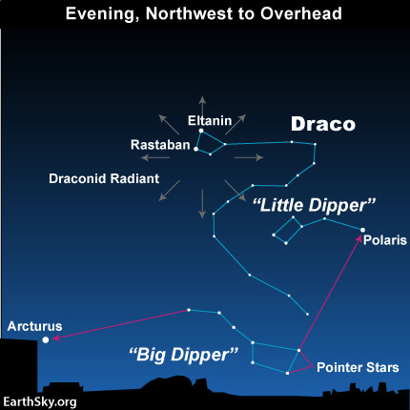
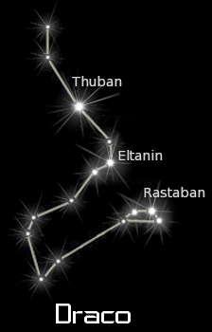
7. Draco the Dragon

Slide 16
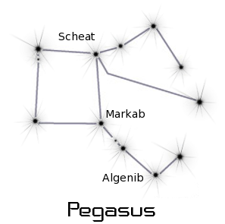
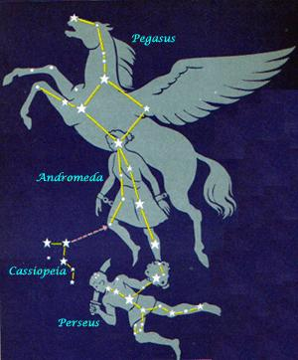
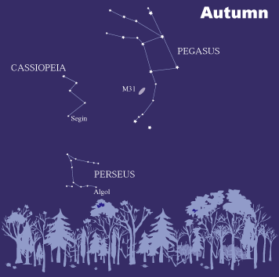
8. Pegasus

